Slide 1
RETAIL BANKING and E – Commerce Retail Product Database Analysis.
-BY
Group 3

Slide 2
PROBLEM STATEMENT :
Database Schema Creation
Manipulation of DATABASE.
Access information for the Retail Banking and e-commerce.
Meaningful insights and business driven decision.
Determine inventory status for different products.
Analysis of past sales.

Slide 3
DATA DESCRIPTION:
Data consists of Bank and E-Commerce Product Business Details.
Bank Schema consists of : Accounts, Branch, Customers, Employees and Transaction tables.
E-Commerce Schema consists of Address, Carton, Online Customer, Order Header, Order Items, Product, etc.
Detailed information w.r.t domains were given in the different tables.

Slide 4


Problem Solving Steps (Retail Banking):
Created the database and studied ER-Diagram.
Found out the Unique Occupation of Customer (using “distinct”).
Added “city” column in “Branch Table”.
Extracted account information by sorting “current balance”.
Found DOB of customer “RAMESH”.

Slide 5
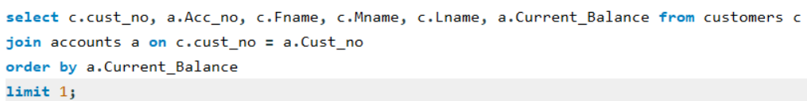
Updated middle and last name of employee “Bella”.
Retrieved info of opened accounts in specified dates.
Customers with ‘a’ as the second letter in their names.
Customer with lowest balance amount.

Slide 6
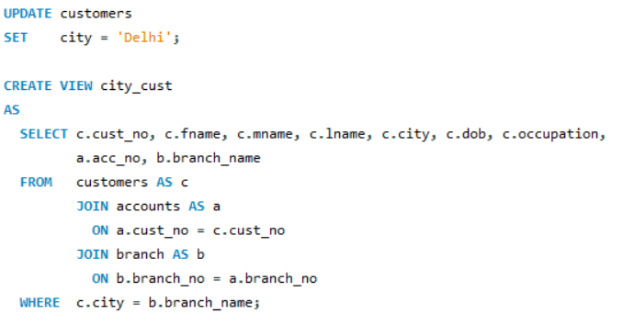
Count of customer for each occupation.
Employees with “MANAGER” designation.
Employee details from department ‘loan’ or ‘credit’.
Created a virtual table for customers having
Account and location in same city.

Slide 7
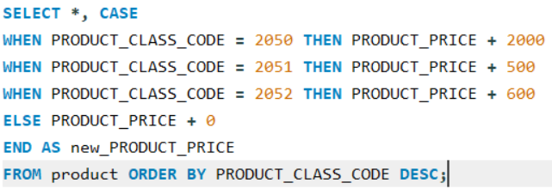
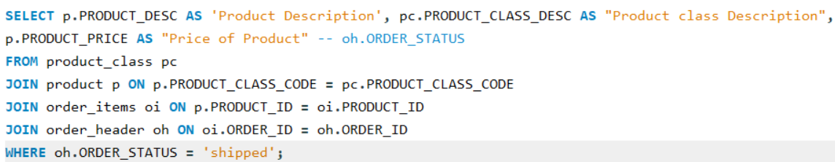
Problem Solving Steps (E-Commerce Retail Product Analysis):
Retrieving info by manipulating price w.r.t product code.
Retrieve product details for the products which were “shipped”.

Slide 8
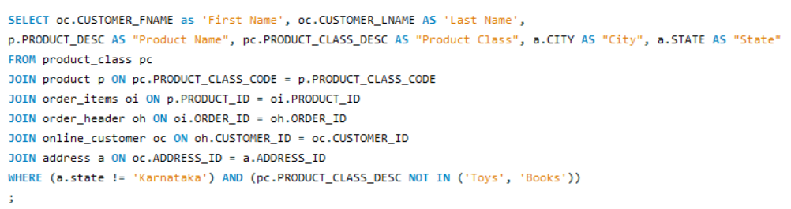
Non Karnataka customers who haven’t bought any toys or books.

Slide 9
What could have been done better?
Missing values for “city” attribute in customer table.
Improper interconnections between the tables.
A proper case study would have been more better.

Slide 10
Takeaway and Conclusions:
Study of Data and Data Domain.
ER-Diagram Analysis.
Neat SQL queries.
Learned Trigger’s.
Importance of continuous learnings.
Scope of improvement.

Slide 11
THANK YOU!!

